Slide 1
Week 8 Video 2
Discovery with Models: Case Study

Slide 2

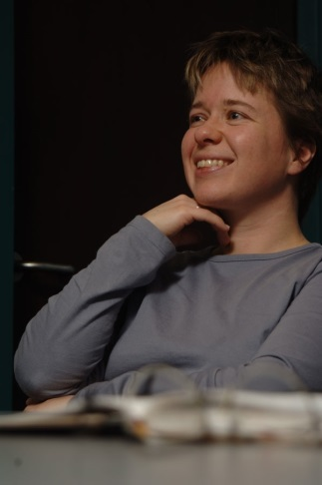
Case Study
Dawson, S., Macfadyen, L., Lockyer, L., & Mazzochi-Jones, D. (2011). Using social network metrics to assess the effectiveness of broad-based admission practices. Australasian Journal of Educational Technology, 27(1), 16-27.

Slide 3
An Example of DWM in Relationship Mining

Slide 4
Goal
Try to understand which attributes of a medical school candidate, at the time of application to medical school
Are predictive of successful participation in the emerging community of practice during medical school
Towards evaluating medical school applicants for modern medicine where communication and community participation are key

Slide 5
How to measure?
Not entirely clear how to measure participation in community
Idea
Multiple measures of student participation in discussion forums within medical school LMS

Slide 6
Several measures (and their hypothesized meaning)
Nodal degree – number of relationships to other students
Closeness – distance in communication to all other students
Betweenness – students that connect other students
Eigenvector centrality – an individual student’s contribution to the community

Slide 7
Data about students at time of admission
Prior course grades (GPA)
Standardized exam score (GAMSAT)
Portfolio
Interview
Set of rigorous mini-interviews with standardized questions
Questions assess critical thinking, decision making, communication skills, leadership, knowledge of health care

Slide 8
Results
Social Network Measures and GPA
No significant correlations
Social Network Measures and GAMSAT
No significant correlations
Social Network Measures and Portfolio
No significant correlations, except in 1 of 4 subpopulations

Slide 9
Results
Social Network Measures and Interviews
Closeness: r= 0.311
Eigenvector: r= 0.152

Slide 10
More Results: Admissions Criteria and Class Grades during Medical School
Prior GPA: r= 0.172
GAMSAT: r= 0.188
Interviews: r= 0.253

Slide 11
Conclusion
Interviews are better predictor of both grades and participation in medical school social network than other measures
Keep interviews in the medical school admissions process

Slide 12
Interesting Point
Using measures that can be distilled from data quickly
Research questions can be answered that were never considered by the original developers of those measures
Discovery with Models at its bests

Slide 13
Next lecture
Text Mining

